Slide 1
FACE RECOGNITION SYSTEM USING PYTHON
Authors : Sowmyashree O A , Rakshitha Shankar , Sagar T V , Thrupthi M S
Dept. of Computer Science & Engineering
Channabasaveshwara Institute of Technology, Gubbi, Karnataka, India.

Slide 2
CONTENTS
INTRODUCTION
RESEARCH GAP
FLOWCHART OF FACE RECOGNITION
ADVANTAGES AND DISADVANTAGES OF FACE RECOGNITION
RELATED WORK
IMPLEMENTATION
RESULT AND ANALYSIS
CONCLUSION

Slide 3
INTRODUCTION
One of the best technology.
Performing difficult tasks.
Live video and video cam images.
The rapid increase in computational resources .
Face recognition in Python with openCV and Haar cascade.
Detect people’s faces in images.
face is a list of coordinates for rectangular regions where faces were found.

Slide 4
RESEARCH GAP
No. | Referred Projects | Technique
1. | “Real Time Face Detection and Tracking Using OpenCV” | Haar Classifier, SimpleCV and OpenCV framework libraries.
2. | ”Facial Detection Recognition Using Open CV library” | 3D Face Recognition (or) Active Appearance Models
3. | ”Face Detection and Tracking Using OpenCV ” | image-based approaches
4. | ”Human Face Detection Techniques”, | face detection algorithms
5. | ”Face Recognition System” | KLT Algorithm, Viola-Jones Algorithm, and Haar cascade classifier

Slide 5
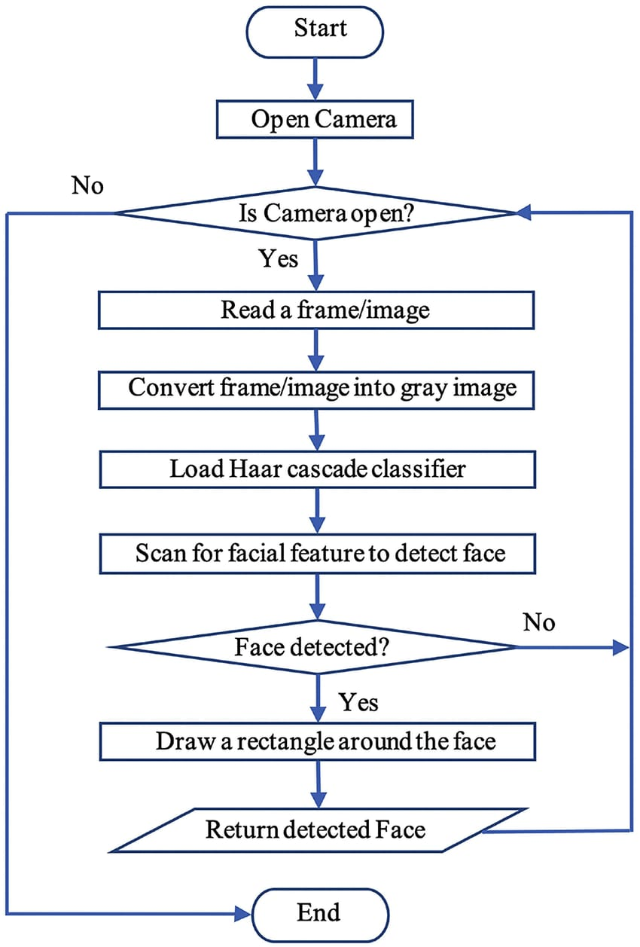
FLOWCHART OF FACE RECOGNITION

Slide 6
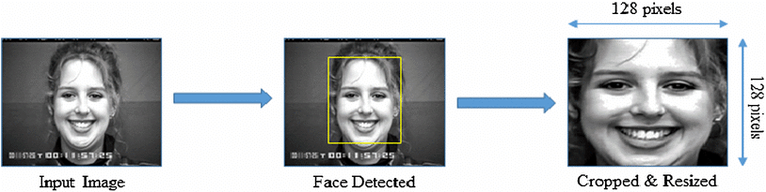
Fig 1: example of an face detection

Slide 7
ADVANTAGES
DISADVANTAGES
Helps find missing people.
Protects businesses against theft.
Improves medical treatment.
Strengthens security measures.
Makes shopping more efficient.
Improves photo organization.
Threatens privacy.
Imposes on personal freedom.
Violates personal rights.
Data vulnerabilities.
Misuse causing fraud and other crimes.
Technology can be manipulated.

Slide 8


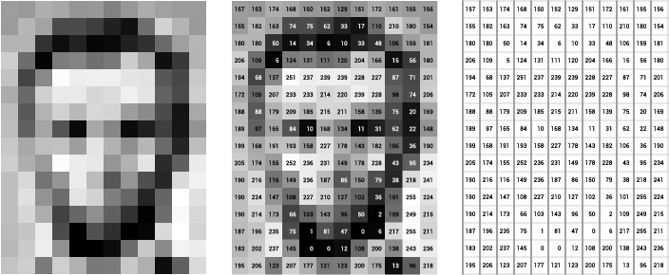
RELATED WORK
openCV :
OpenCV (Open Source Computer Vision Library) is a programming function library primarily aimed at real-time computer vision.
Reading an Image : Color photos, grey-scale images, binary images, and multi spectral images are all types of digital images.
Fig 2: Binary image
Fig 3: color image
Fig 4:Grey-scale image

Slide 9
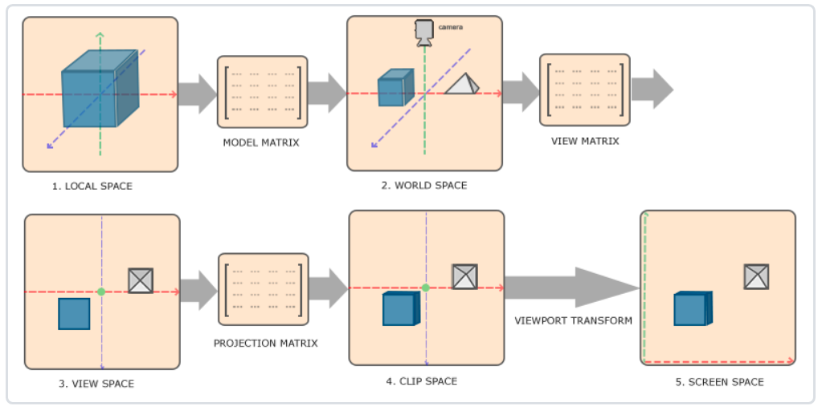
Properties Of Image :
Shape : There is a shape to every image. The shape of the picture’s boundaries, i.e. the height ,width and length.
The ”type” method provides information on how picture data is represented
The data type of the image you have just read
Image pixel values
Image Resolution
Viewing the Image
Saving the Image
Fig 5: converting local to normalized coordinates

Slide 10
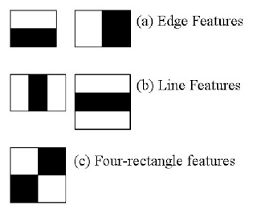
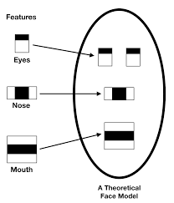
IMPLEMENTATION
Haar Cascade Classifier:
Haar Cascade is an Object Detection Algorithm that can be used to recognise faces in images or real-time videos.
It’s a machine-learning approach in which a cascade function is learned using a large number of positive and negative photos.
Fig 6: types of cascade features
Fig 7: feature based on face detection

Slide 11
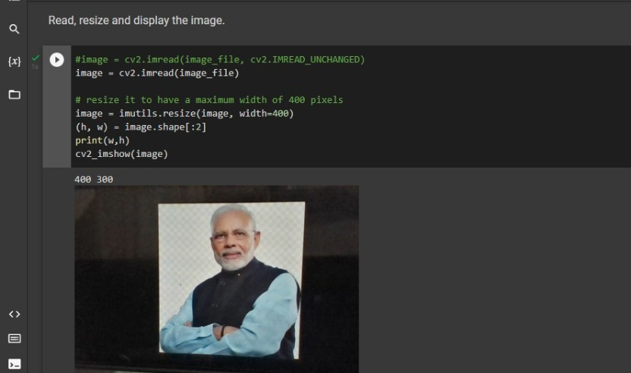
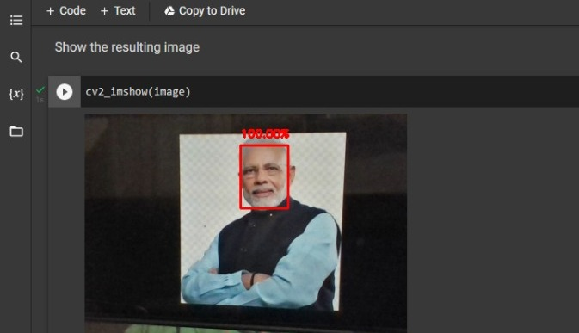
RESULT AND ANALYSIS
Massive databases and noticing emerging patterns to make sense of images.
After looping over the detections, draw boxes around the detected faces. Show the image that results. The recognition technique is straightforward and effective.
Fig 8: Read, Resize and display images
Fig 9: Resulting image

Slide 12
CONCLUSION
Face detection is used in a variety of areas, including security and human tracking.
better decisions on datasets and enhance facial recognition accuracy by taking more and more images of each person.
In the future, a specific camera for face recognition may be developed, which will increase image quality and tackle challenges such as image filtering, image reconstruction, and de-noising.

Slide 13
THANK YOU

Slide 14

ANY QUESTIONS

